Slide 1


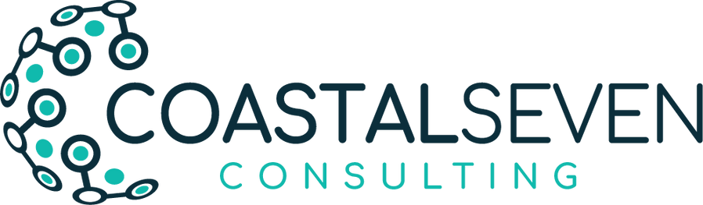




TALENT AS A SERVICE
(TAAS)
We don’t just hire talent – we build it.
www.coastalseven.com

Slide 2


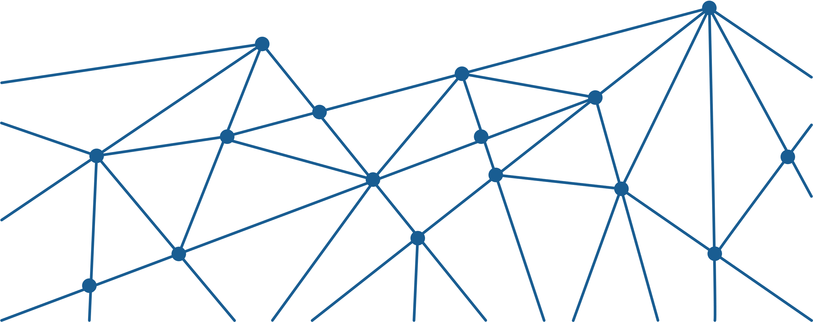
WHY TAAS?
Talent Shortage
•According to the World Economic Forum, 75% of companies struggle to find qualified tech talent.
•A recent Gartner report shows that IT talent gaps hinder 64% of technology projects.
•Only 1 in 4 engineering graduates in India are considered employable in software roles (Aspiring Minds, 2023).
Traditional hiring is reactive
•Traditional hiring processes take 6–12 weeks to fill tech roles, delaying project timelines.
•Reactive hiring results in higher attrition rates (~25%) due to poor role fit and lack of preparation.
•TAAS creates pre-vetted, job-ready candidates, cutting hiring cycles by 50%.
Upskilling young engineers
•Continuous learning pipelines reduce external hiring dependency by 40%.
•Companies with structured internship-to-hire programs have higher retention rates (~80%).
•Upskilled hires reach full productivity 30–50% faster than direct hires.

Slide 3
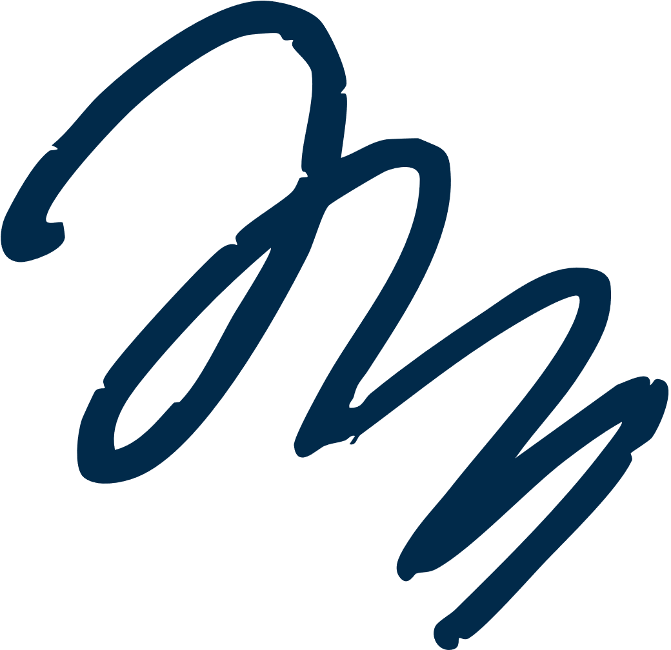










OUR VISION ?
Building Great Teams
We are not just creating individual contributors but assembling high-performance, cross-functional teams ready to solve real-world problems from Day 1.
Building Great Talent
We believe talent is built, not bought. Through the Knowledge Factory, we shape technically sound, business-aware, and collaborative engineers who thrive in dynamic environments.
Building Great Culture
Mentorship, continuous learning, accountability, and innovation are at the heart of our culture. The Knowledge Factory embeds these values into every engineer we grow.
Sustainable Impact
Our mission is to create a self-sustaining talent ecosystem that fuels Coastal Seven’s growth and helps us stay ahead of the industry’s evolving needs.

Slide 4


LEADER
EXPECTATION
Hire for expertise that complements team’s existing skillset.
Hire with consideration for both diversity and cultural fit
Provide support to accelerate cultural assimilation
Set Team Member up for success
Lay the groundwork for Team Member engagement and retention

Slide 5

TEAM MEMBER EXPERIENCE
Motivated, welcomed and supported
Heard and understood, that opinions and potential will be valued
Part of the team and assimilated into the culture quickly
Cared for as a person
Trusted and autonomous

Slide 6





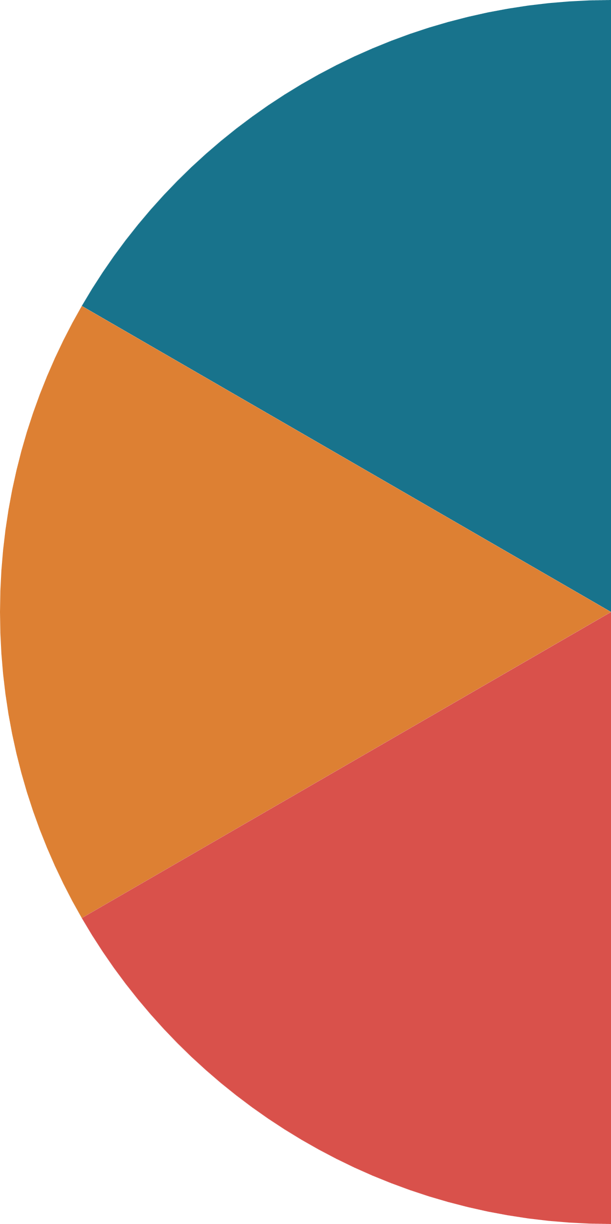







Recruiting and Onboarding New Joiners
1
4
Growth Mindset:
Focus on both current competencies and potential of Team Member.
Feedback Culture :
Regularly solicit feedback from Team member about his/her Onboarding experience,
2
Key to
Success
5
Courageous Conversations:
Foster open, honest dialogues, empowering to speak up, ask questions, and grow with confidence.
Collaboration:
Introduce Team Member to leaders and create opportunities for relationship building.
3
6
Decision Making:
Provide guidelines and clear boundaries for decision making
Psychological Safety : Encourage Team Member to ask questions and clarify doubts on all matters.

Slide 7

Internship Journey
Finale: Hackathon & Hiring
6-Week Immersive Internship Experience
Evaluation Criteria
What They Learn ?
•Real-world Hackathon to simulate product release pressure.
•Offers to top performers based on overall performance.
Work on Real Full-Stack Projects
Be Part of Real Teams
Continuous Evaluation & Mentoring
Technical Skills
Teamwork & Communication
Ownership & Accountability
Learning & Growth
Business Thinking
Core Engineering Skills:
•Frontend Development (React, Angular, etc.)
•Backend Development (Python, Node.js, Java)
•DevOps & CI/CD
•API Design & Integration
•Database Design.

Slide 8














MEASURABLE OUTCOMES
Sustainable Talent Pipeline
Accelerated Time-to-Productivity
80% of interns seamlessly transitioned into full-time engineering roles, fueling long-term team growth.
Reduced onboarding and ramp-up time by 40%, enabling faster project contributions.
Business-Aligned Outcomes
Future-Ready Engineering Talent
Intern projects delivered tangible value, earning positive feedback from mentors and business stakeholders.
Nurturing engineers equipped with real-world skills, product thinking, and a strong ownership mindset — ready to solve tomorrow's challenges.

